Slide 1
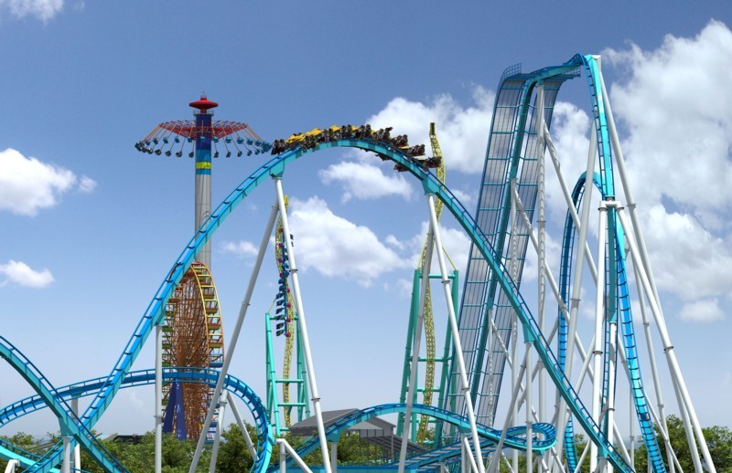


Slide 2
List of Magic Land Theme Park Rides
Bumper cars
Carousel
Caterpillar
Chairlift
Ferris wheel
Fireball
Fun Slide
Mechanical bull
Monster
Paratrooper
Pendulum rides
Power Surge
Rainbow
Red Baron
Reverse bungee
Rollercoaster in pool
Skydiver
Teacups
Tornado
Water slides
Wipeout

Slide 3
Zones of Magic Land
Theme park
Hotel
Restaurants
Adult pool (includes a bar in it)
Kid’s pool
Mini Mall
Kidsville

Slide 4
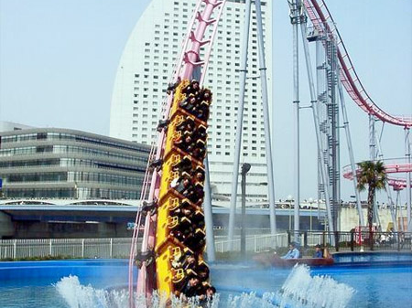
The world’s only roller coaster in pool

Slide 5
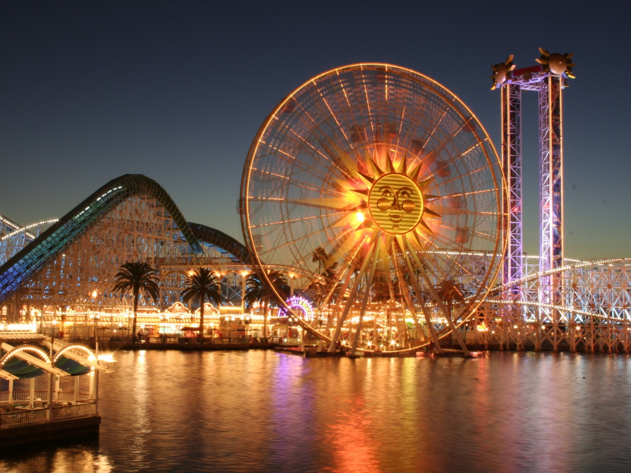
Ferris Wheel

Slide 6
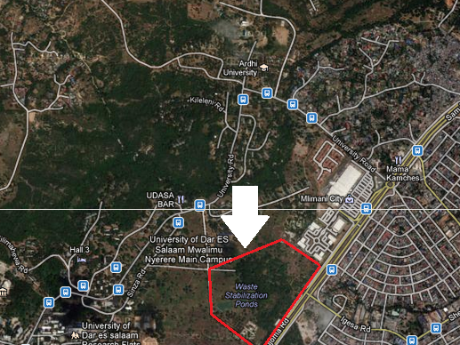
Location of Magic Land,
Sam Nujoma rd near Mlimani City

Slide 7
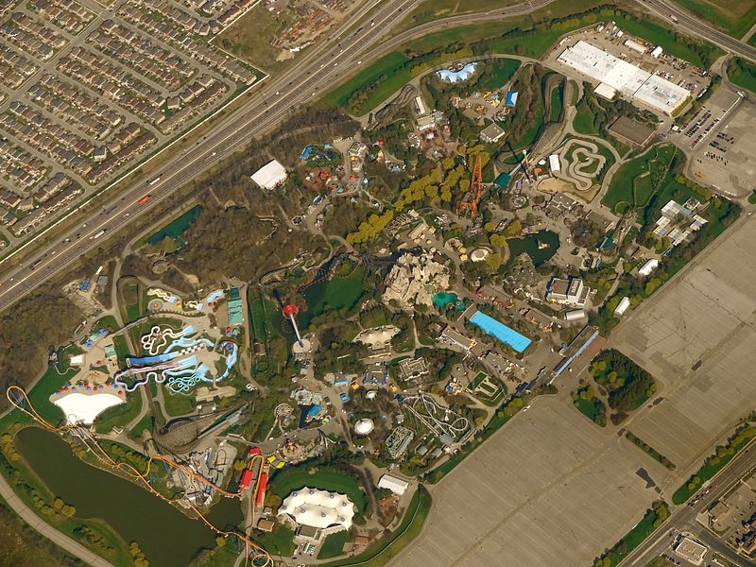
A concept of Magic Land (top view)

Slide 8
Description
Magic Land is a 100 acre theme park project that will be expected to be located at Sam Nujoma Rd, Dar es Salaam, Tanzania, near Mlimani City. Magic Land is the largest theme park in Africa. It will be the turning point of Tanzania’s economy that will help the development of Tanzania. It will attract foreign tourists who think that Africa is just a jungle but it can surprise them when they find out from international advertisements.

Slide 9
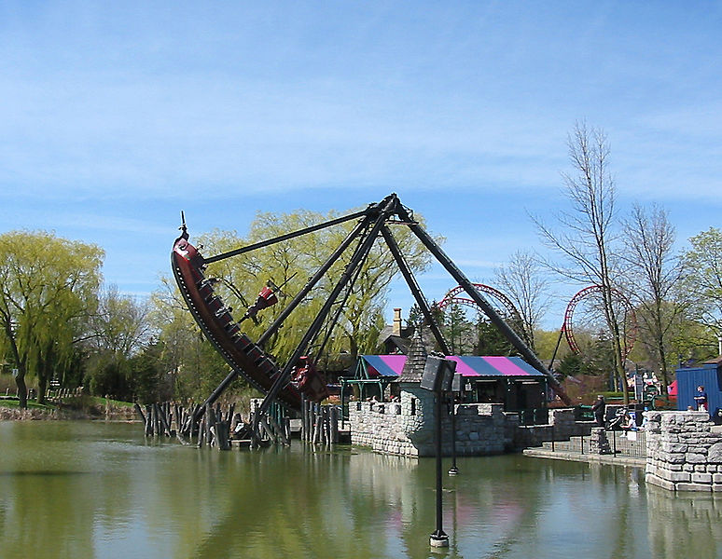
The Rage

Slide 10
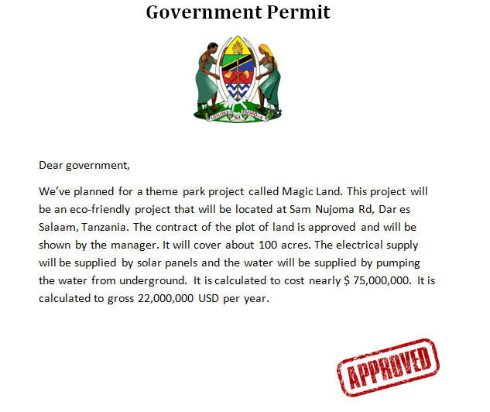
Permit from the government

Slide 11
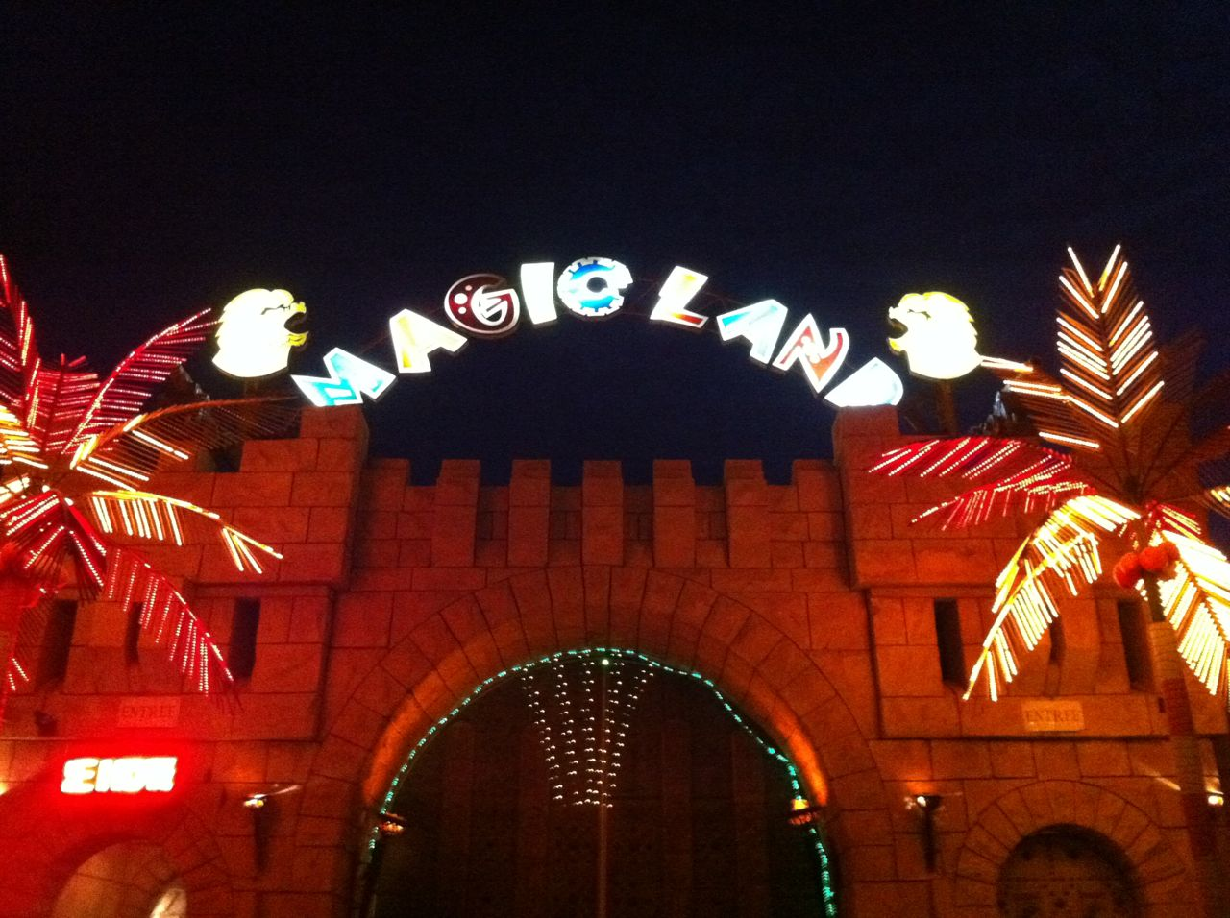
ENTRANCE OF MAGIC LAND – YOU ARE WELCOME

Slide 12
www.magiclandtz.yolasite.com
For more info, please visit:

